Slide 1
“Pathways” to analyze microarrays
Just like the Gene Ontology, the notion of a cancer signaling pathway can also serve as an organizing framework for interpreting microarray expression data.
On examining a relatively small set of genes based on prior biological knowledge about a given pathway, the analysis becomes more specific.
Notes:
Microarray gene expression studies are used in cancer research to identify genes and gene expression patterns that show a consistent change between cancer and normal states

Slide 2
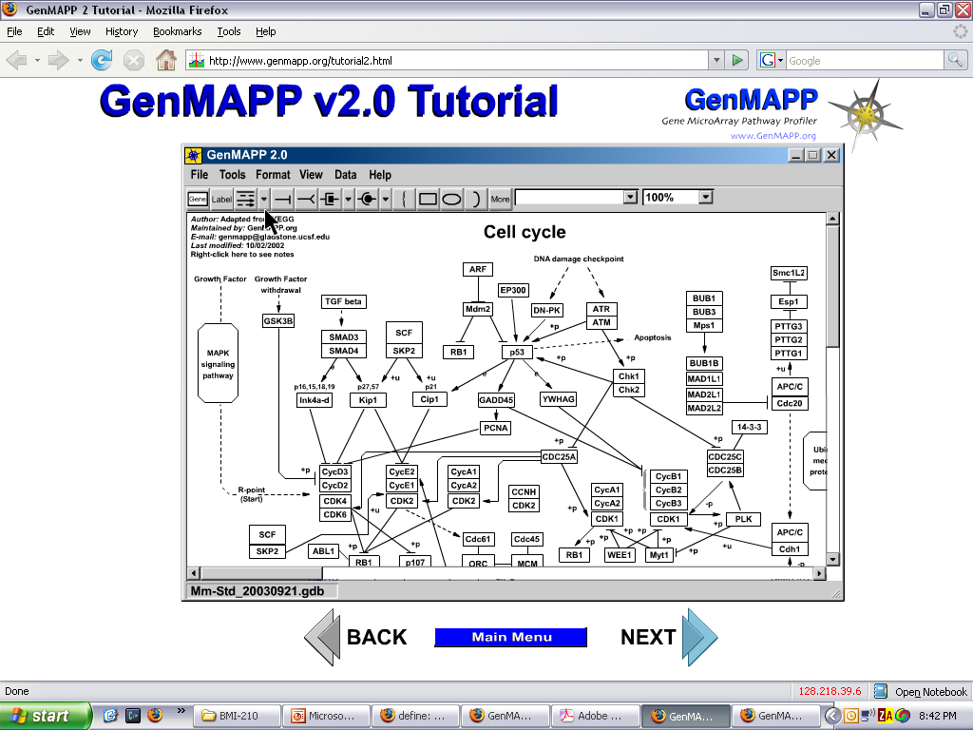

Slide 3
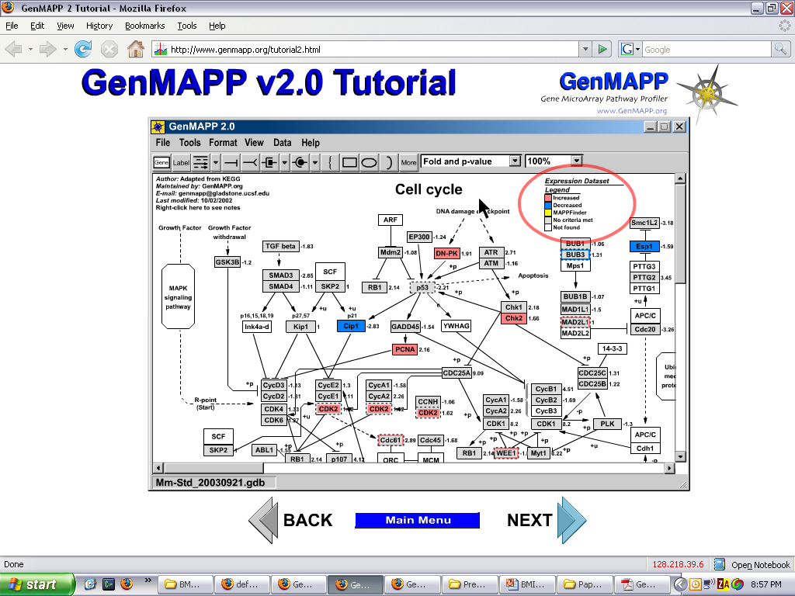

Slide 4
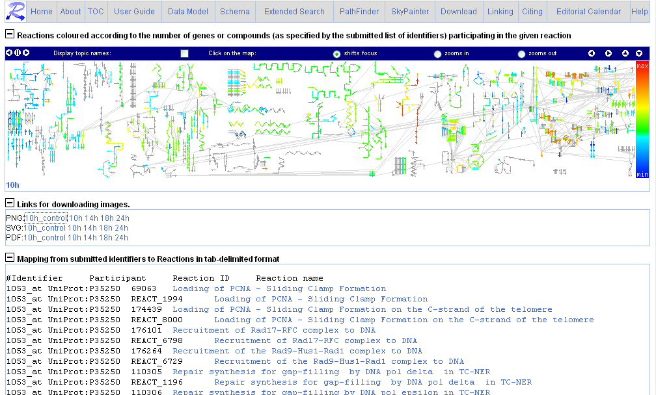
Reactome’s sky painter (demo)

Slide 5
Recap: How do ontologies help?
An ontology provides a organizing framework for creating “abstractions” of the high throughput (or large amount of) data
The simplest ontologies (i.e. terminologies, controlled vocabularies) provide the most bang-for-the-buck
  Gene Ontology (GO) is the prime example
More structured ontologies – such as those that represent pathways and higher order biological concepts – still have to demonstrate real utility.

Slide 6
Going beyond GO annotations

Slide 7
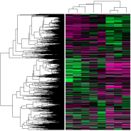
Different kinds of annotations
Assertions
Tags
ELMO1 expression is altered by mechanical stimuli
:
:
Other experiments
:
:
ELMO1 associated_with actin cytoskeleton organization and biogenesis
Expression profiling of cultured bladder smooth muscle cells subjected to repetitive mechanical stimulation for 4 hours. Chronic overdistension results in bladder wall thickening, associated with loss of muscle contractility. Results identify genes whose expression is altered by mechanical stimuli.
Low level result
metadata
summary result
annotation
Chronic Bladder Overdistension
Notes:
Before diving into the details, I want to disambiguate “annotations” a little bit…

Slide 8
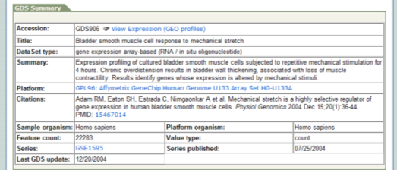
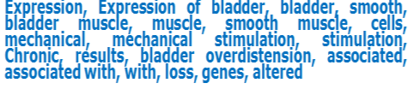
Annotator: The Basic Idea
Process textual metadata to automatically tag text with as many ontology terms as possible.
Notes:
We want to process the text and assign “tags” to each element in public repositories.

Slide 9
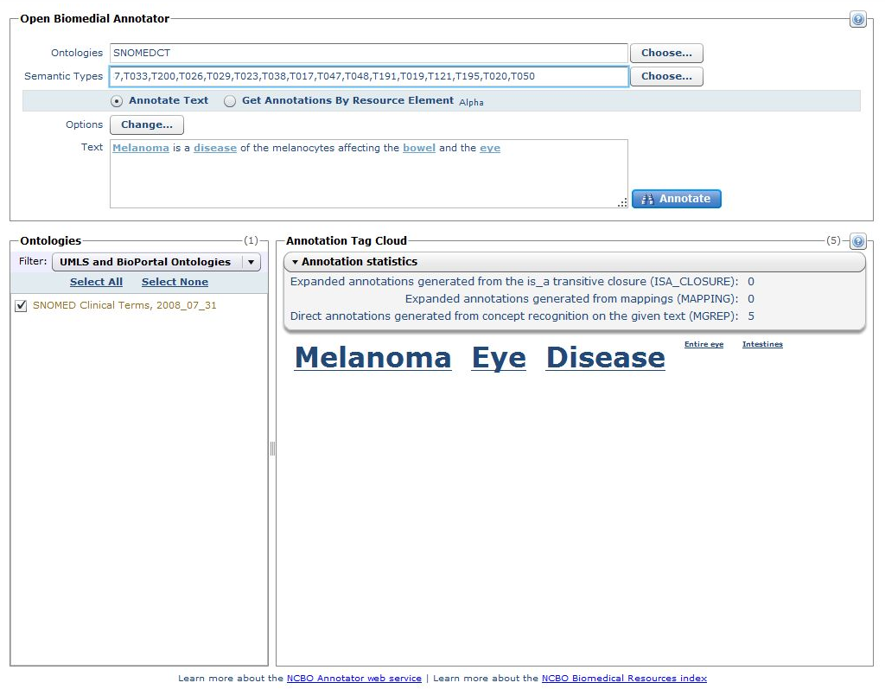
Annotator: http://bioportal.bioontology.org/annotate
Give your text as input
Select your parameters
Get your results… in text or XML

Slide 10
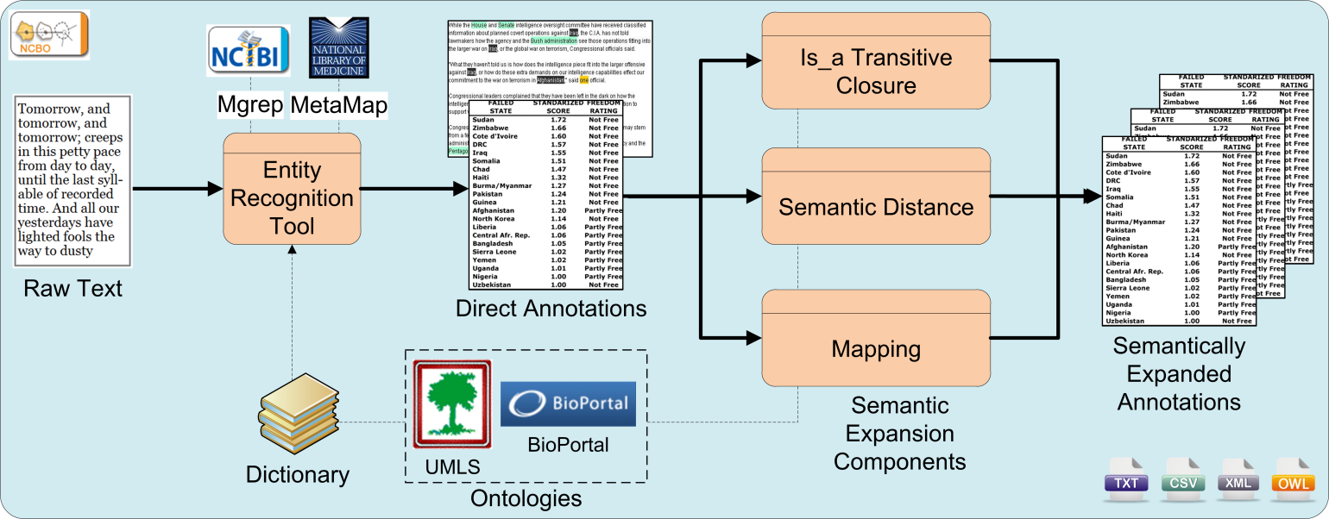
Annotator: workflow
“Melanoma is a malignant tumor of melanocytes which
are found predominantly in skin but also in the bowel and the eye”.
  NCI/C0025201, Melanocyte in NCI Thesaurus
  39228/DOID:1909, Melanoma in Human Disease
Transitive closure
  39228/DOID:191, Melanocytic neoplasm, direct parent of Melanoma in Human Disease
  39228/DOID:0000818, cell proliferation disease, grand parent of Melanoma in Human Disease

Slide 11
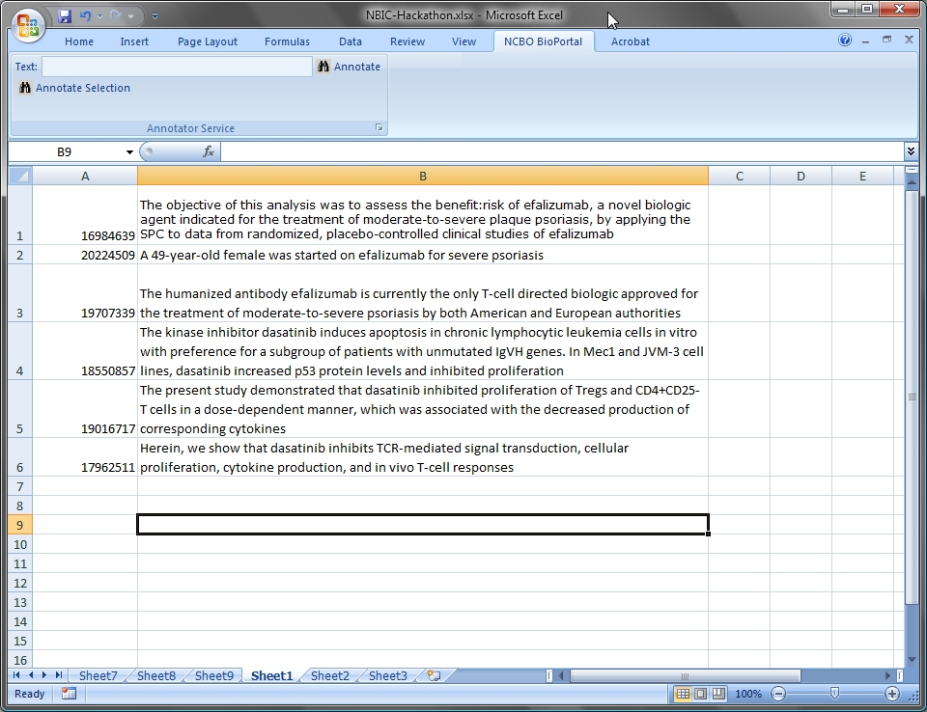
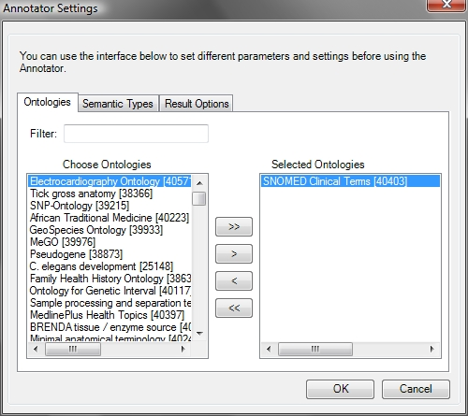

Slide 12
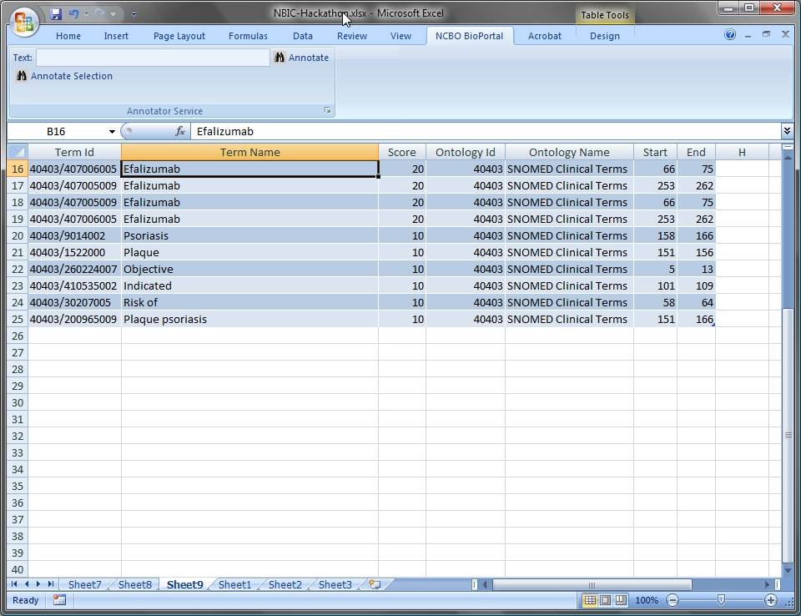

Slide 13
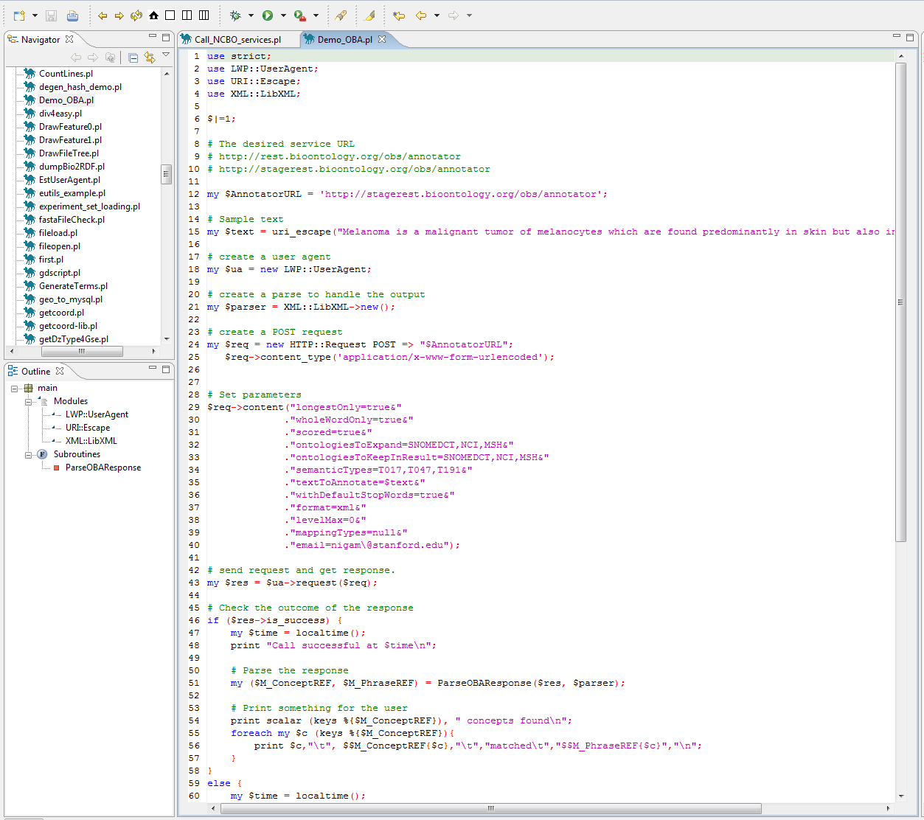

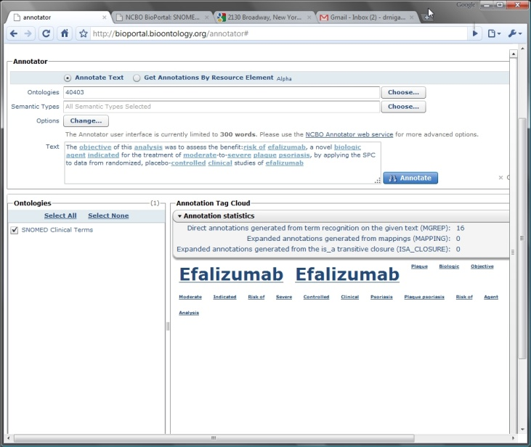
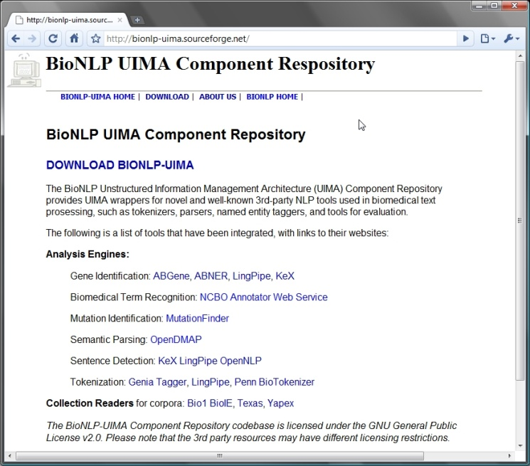
Multiple ways to access
Code
Excel
Word Add-in to call the Annotator Service
?
UIMA platform
Specific UI
Annotator service
Notes:
Elsevier SciVerse
Karen Dowell, Jackson Lab
Shai-shen Orr, Mark Davis’s lab
Sean Mooney’s group
Ida Sim, UCSF
Simon Twigger, Medical college of Wisconsin
Nathan Baker, Washington Univ.
Amit Seth, Wright State Univ.
Neil Sarkar, University of Vermont
Larry Hunter, University of Colorado, Denver

Slide 14
Use-cases based on automated annotation

Slide 15
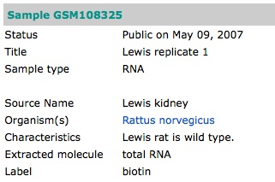

Linking annotations to data
(by Simon Twigger)
Tm2d1
RGD1306410
Svs4
+
Hbb
Scgb2a1
Alb
Hbb is_expressed_in rat kidney
Tm2d1 is_expressed_in rat kidney
Human (U133, U133v2.), Mouse (430, U74, U95) and Rat
(U34a/b/c, 230, 230v2)
62,000 samples x ca. 25,000 genes/sample = 1.5B data points

Slide 16
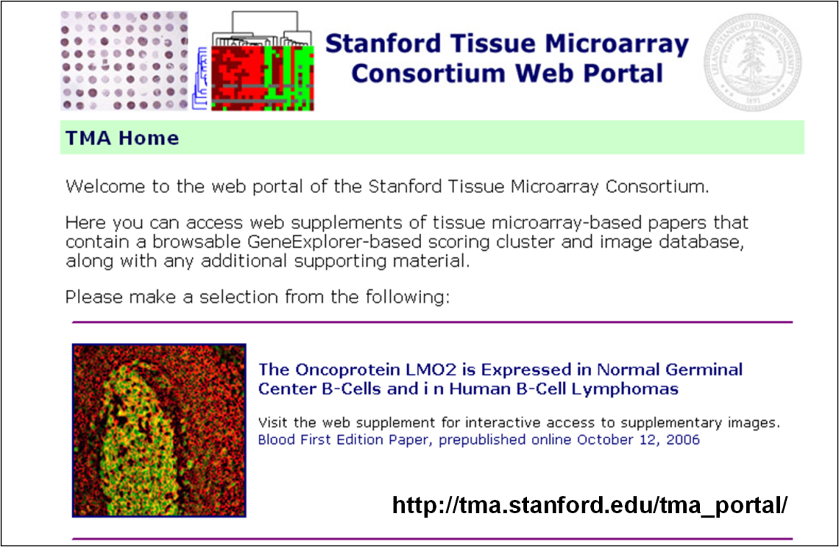
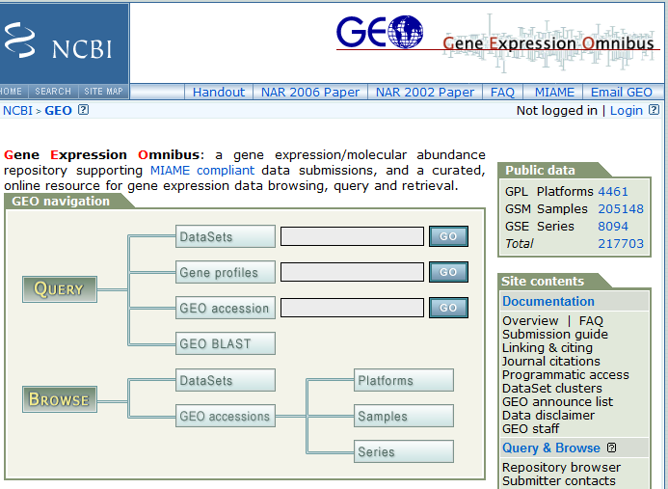
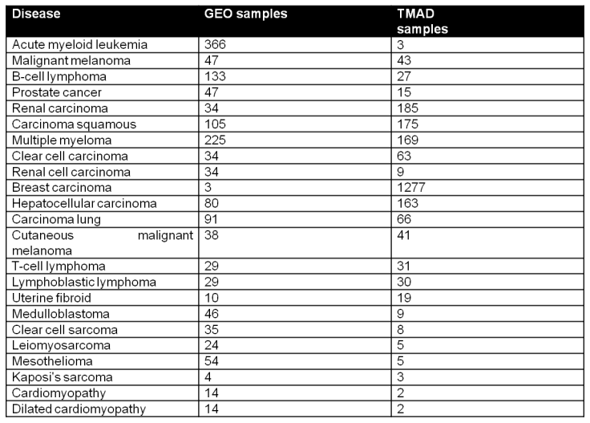
Ontology based annotation
Selected @ AMIA-TBI, Year in review
20 diseases

Slide 17
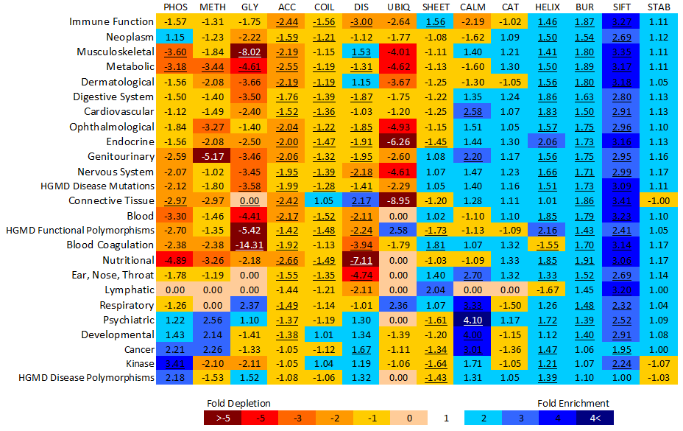
Mutation Profiling
Selected @ AMIA-TBI, Year in review
Matthew Mort, Uday S. Evani, … Nigam H. Shah … Sean D. Mooney
In Silico Functional Profiling of Human Disease-Associated and Polymorphic Amino Acid Substitutions. Human Mutation, in press
Notes:
Fold-enrichment for the distribution of wild-type structural and functional sites for different disease concepts from the UMLS (Unified Medical Language System). Fold-enrichment for each disease concept is compared against a dataset of putatively neutral polymorphisms (SeattleSNPs). Statistically significant results are highlighted and underlined (Bonferroni correct p-value <= 0.05). Datasets are GLY = O-linked glycosylation; UBIQ = Ubiquitination; DIS = Protein disorder; PHOS = Phosphorylation; METH = Protein methylation; ACC = Solvent accessibility; COIL = Secondary structure coil; SHEET = Secondary structure beta sheet; CALM = Calmodulin binding site; CAT = Catalytic site; BUR = Buried; SIFT = SIFT score; STAB = Protein stability; HELIX = Secondary structure helix.

Slide 18
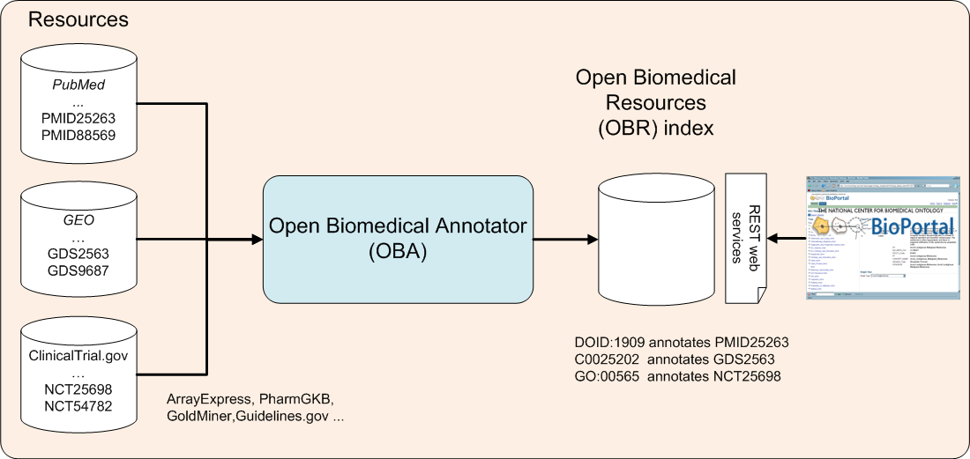
Resources index: The Basic Idea
The index can be used for:
  Search
  Data mining
Notes:
Search:
GEO has > 13 datasets on retroperitoneal tumors, none show up without an ontology based search!
- Did you know that GEO contains more public datasets on drug – gene expression information that Connectivity map?
Data mining:
- Extraction of Conditional Probabilities of the Relationships between Drugs, Diseases, and Genes from PubMed guided by relationships in PharmGKB in AMIA spring translational bioinformatics 2009.

Slide 19
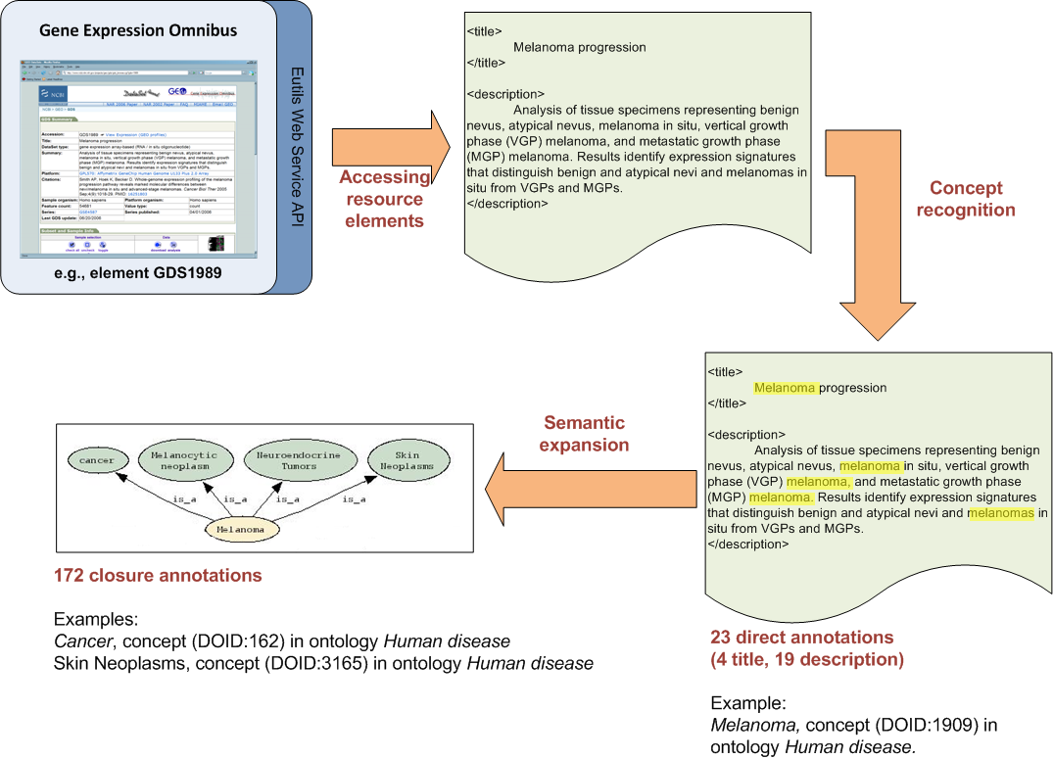

Resources index: Example
Notes:
Indexing an element from GEO. The GEO element GDS1989 is annotated according to its title and its description, as well as by the ontology elements that comprise the transitive closure over the parent–child relationships subsumed by the direct annotations.

Slide 20
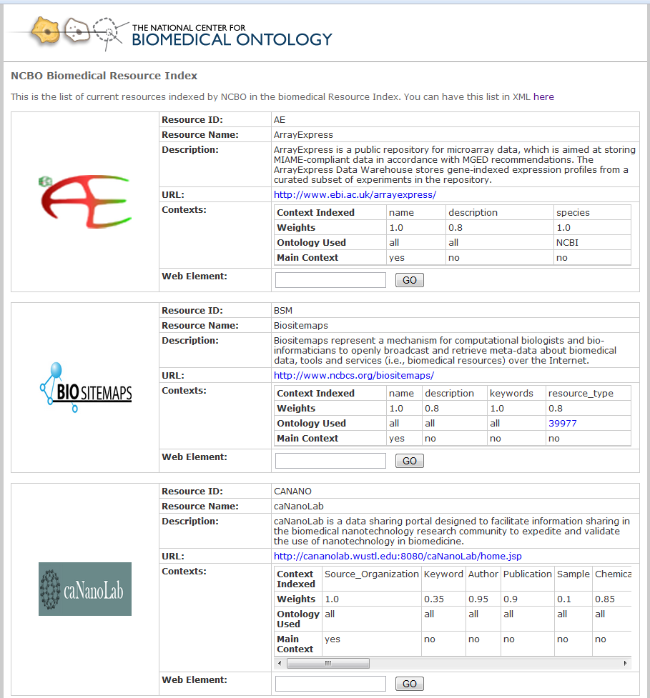
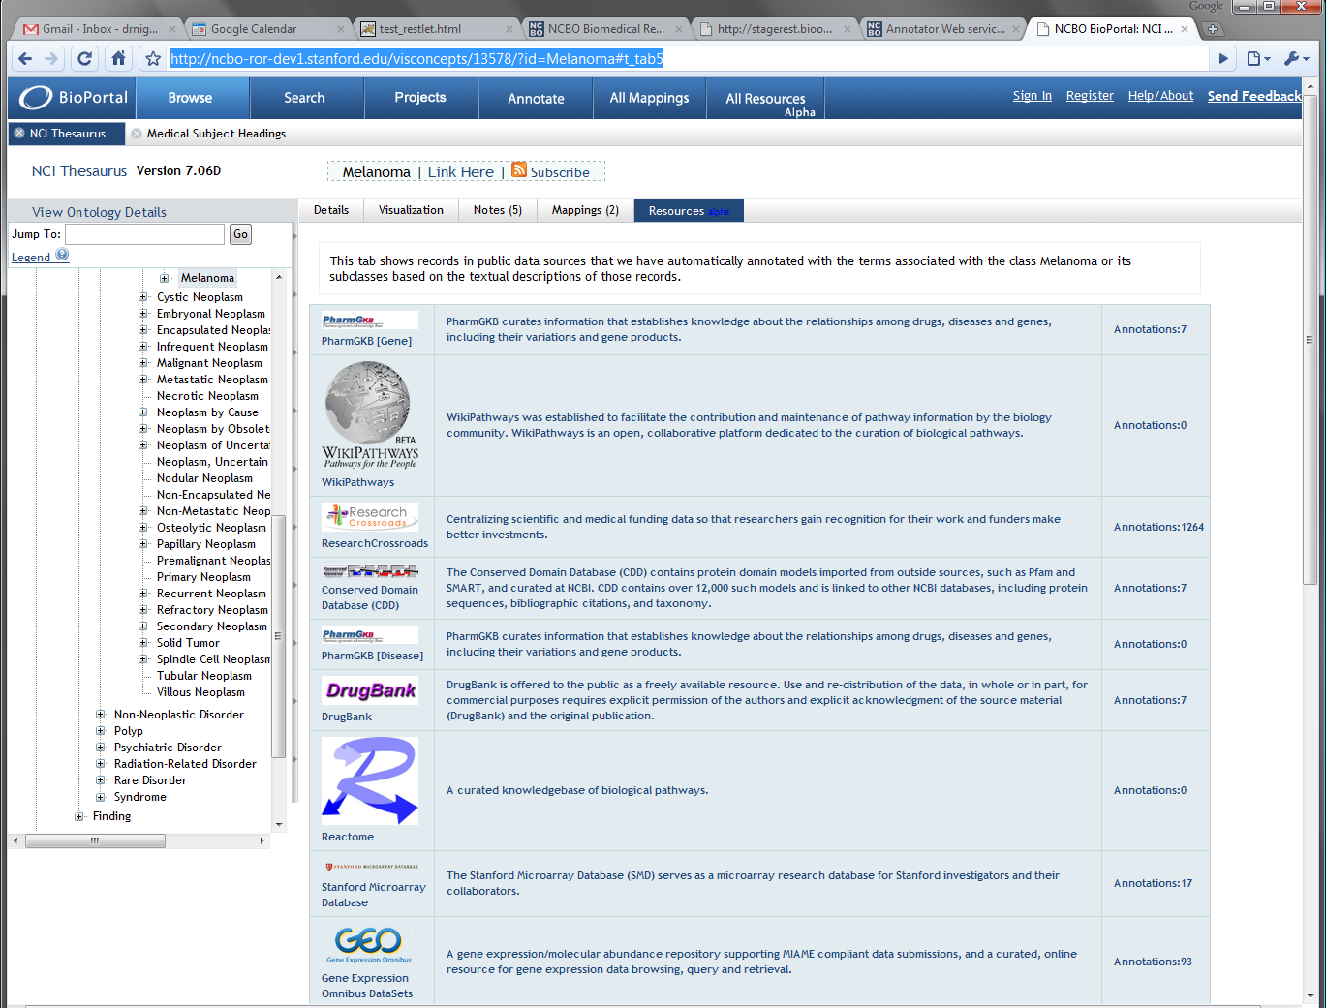
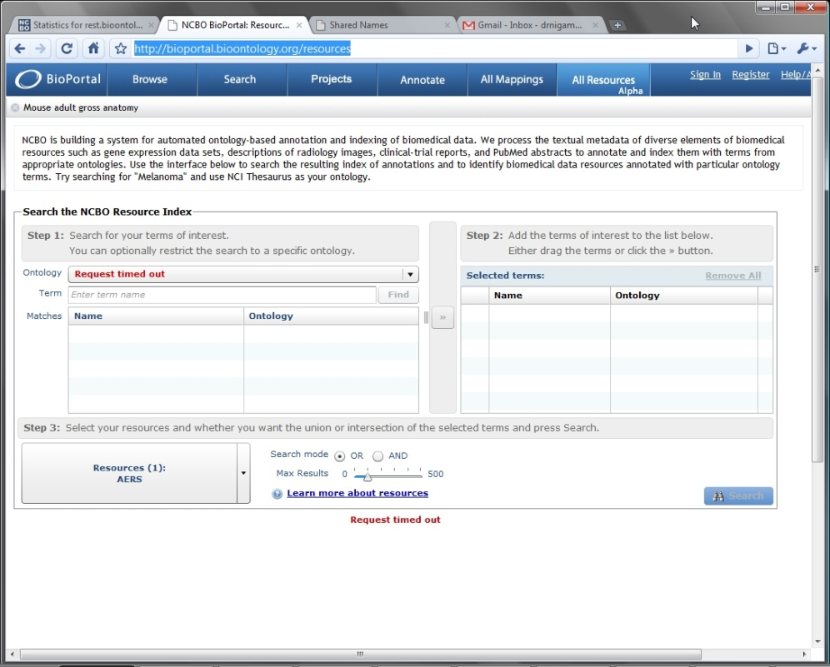
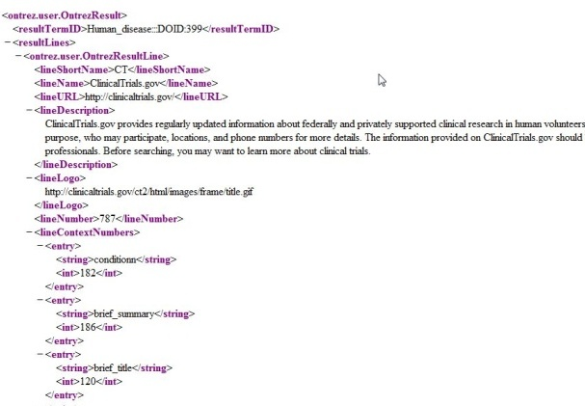
Code
Resource Tab
Custom UI (alpha)
Resources annotated = 20
Total records = 1.3 million
Direct annotations = 371 million
After transitive closure = 5.3 Billion
http://rest.bioontology.org/resouce_index/<service>

Slide 21
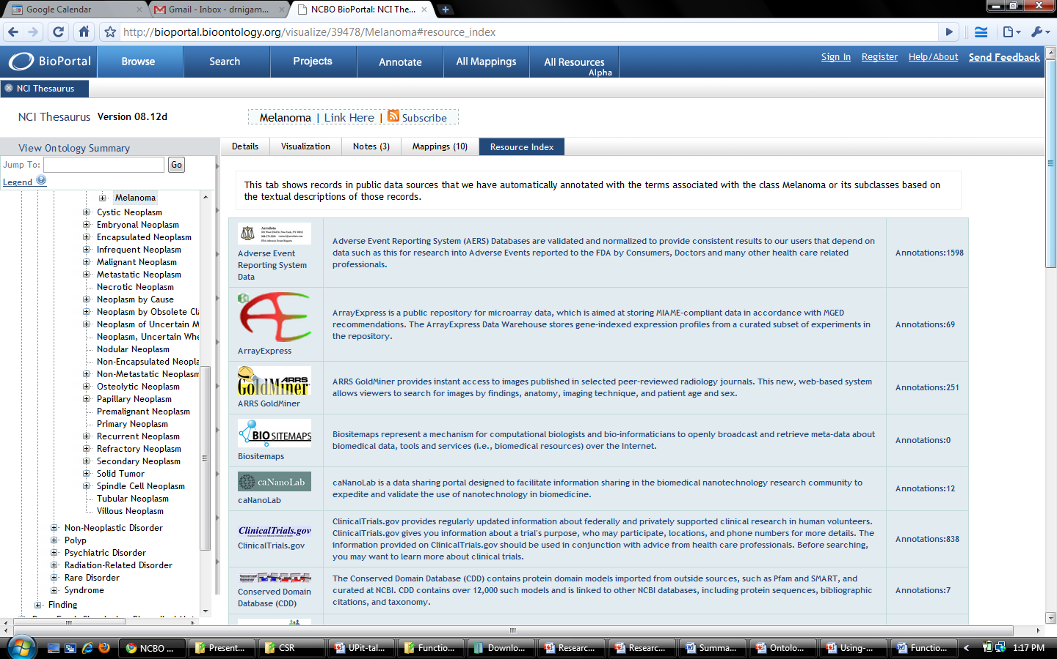
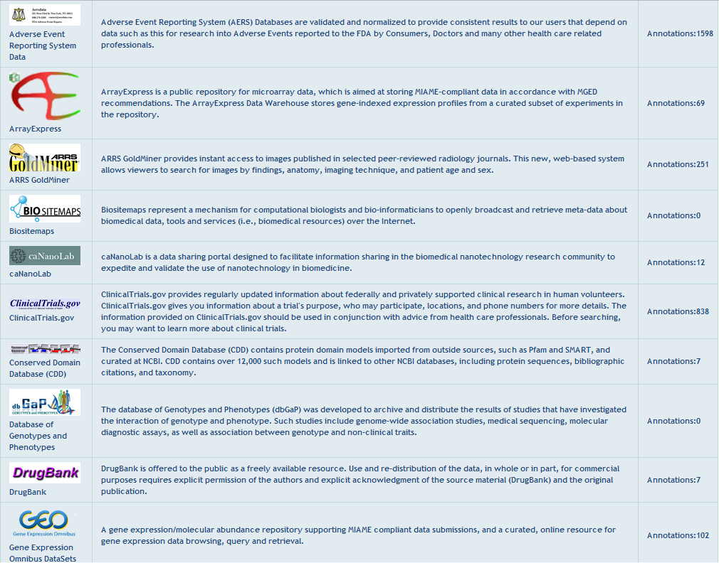
Disease card

Slide 22
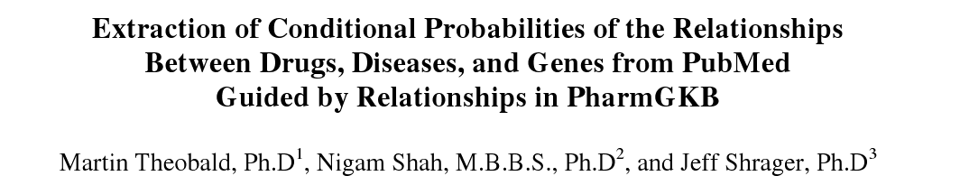
Data mining: Drug, Disease, Gene relationships
Example:
p(salmeterol | Asthma, ADRB2) = 0.07
p(salbutamol | Asthma, ADRB2) = 0.16
At best these are pointers to hypotheses:
  Stronger biomarker?
  More reported side effects?
  Simple recency?
  Many interpretations are possible!
Notes:
CollabRx funded this work .. Jeff Shrager is senior author.

Slide 23
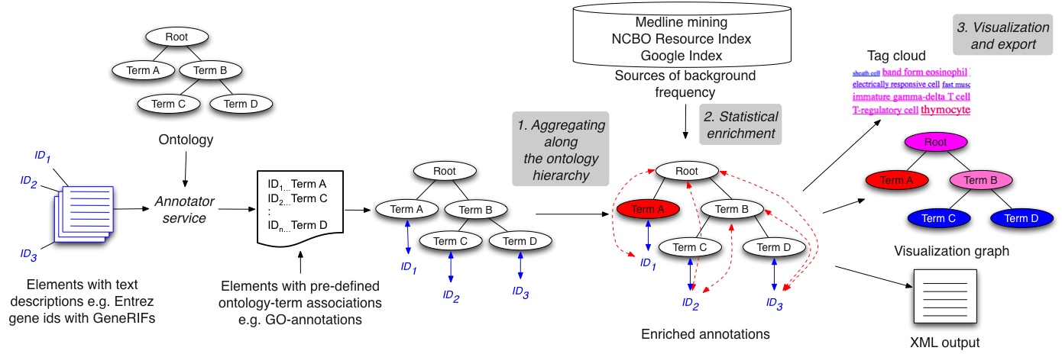
An Ontology Neutral analysis tool
www.bioontology.org/wiki/index.php/Annotation_Summarizer
http://ransum.stanford.edu
Accepted at AMIA Annual Symposium 2010

Slide 24
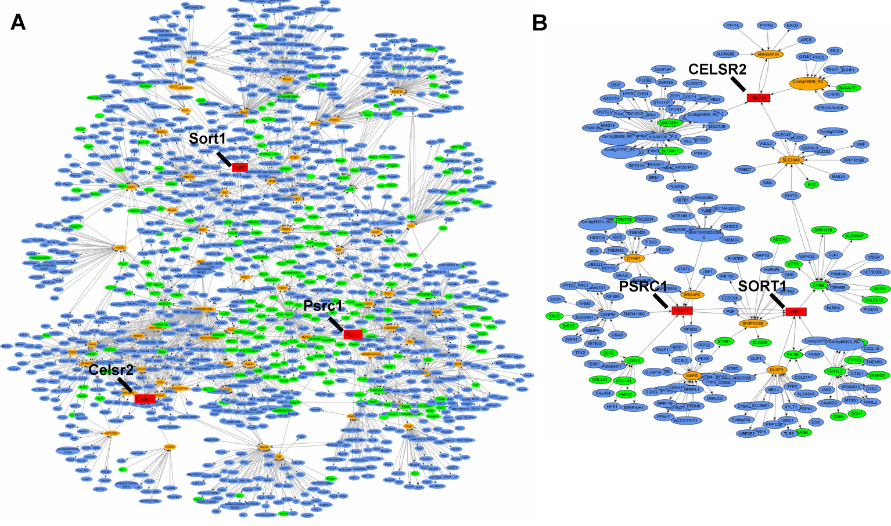
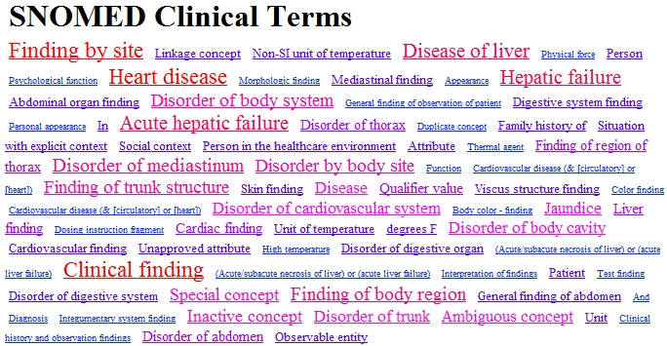
Use-1: Subnetwork Analysis
Schadt et al, PLoS Biology, May 2008
Mapping the Genetic Architecture of Gene Expression in Human Liver

Slide 25
Use-2: Patient cohort analysis
Extended criteria kidney transplant
P (A | B, C …)
Standard criteria Kidney transplant
P (A | B, C …)
Notes:
Compiling the cohort is a non-trivial problem … working with I2B2 to solve the “inter-institutional terminology mapping problem”

Slide 26
DIY Ontology Enrichment Analysis
Live Demo

Slide 27
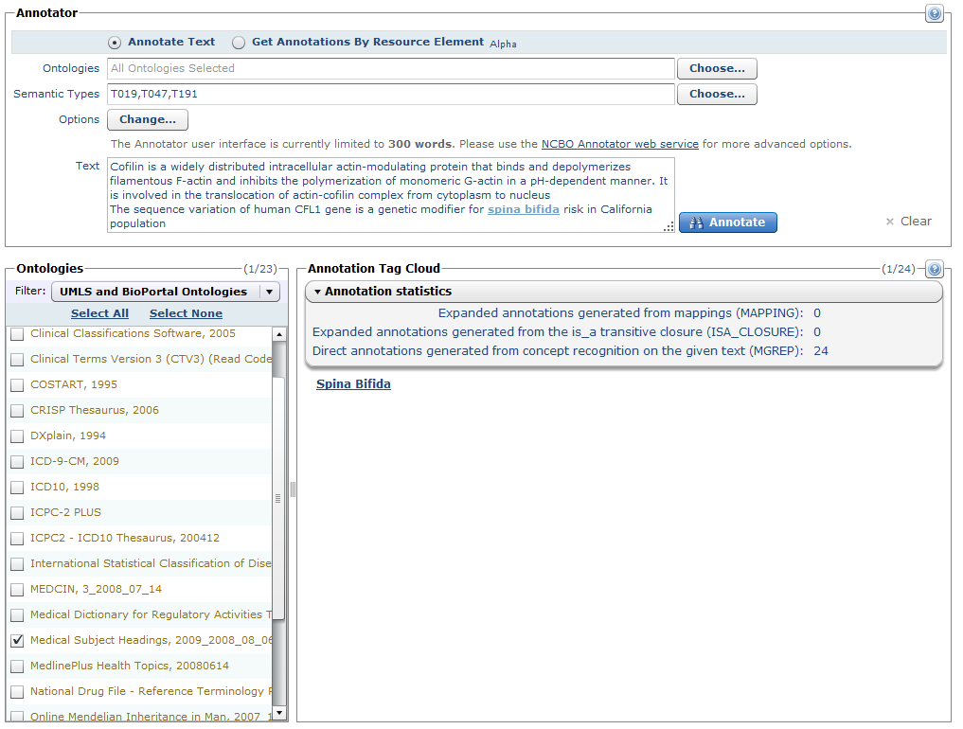
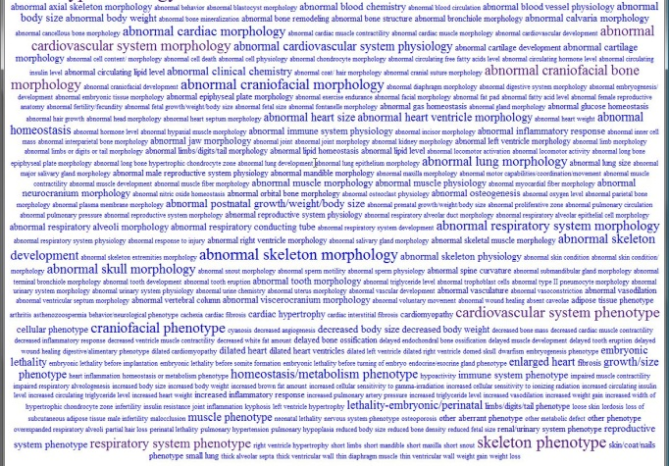
Cofilin is a widely distributed intracellular actin-modulating protein that binds and depolymerizes filamentous F-actin and inhibits the polymerization of monomeric G-actin in a pH-dependent manner. It is involved in the translocation of actin-cofilin complex from cytoplasm to nucleus. … The sequence variation of human CFL1 gene is a genetic modifier for spina bifida risk in California population
Cfl1
:
G-n
Some text …
http://rest.bioontology.org/obs/annotator
Cfl1
spina bifida
http://rest.bioontology.org/obs/rootpath/<ontologyid>/<conceptid>
:
G-n
Some disease condition
Cfl1
spina bifida
:
G-n
Some disease condition
Notes:
Semantic analysis

Slide 28
THE END

Slide 29
Ontology services
Accessing, browsing, searching and traversing ontologies in Your application

Slide 30
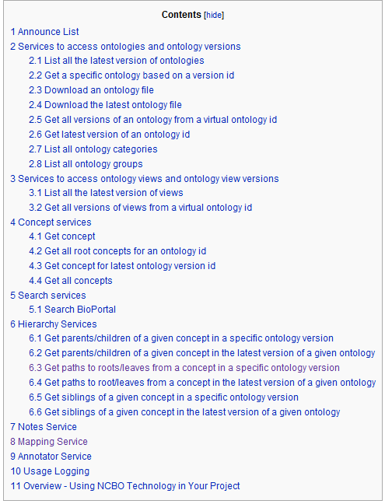
www.bioontology.org/wiki/index.php/NCBO_REST_services

Slide 31
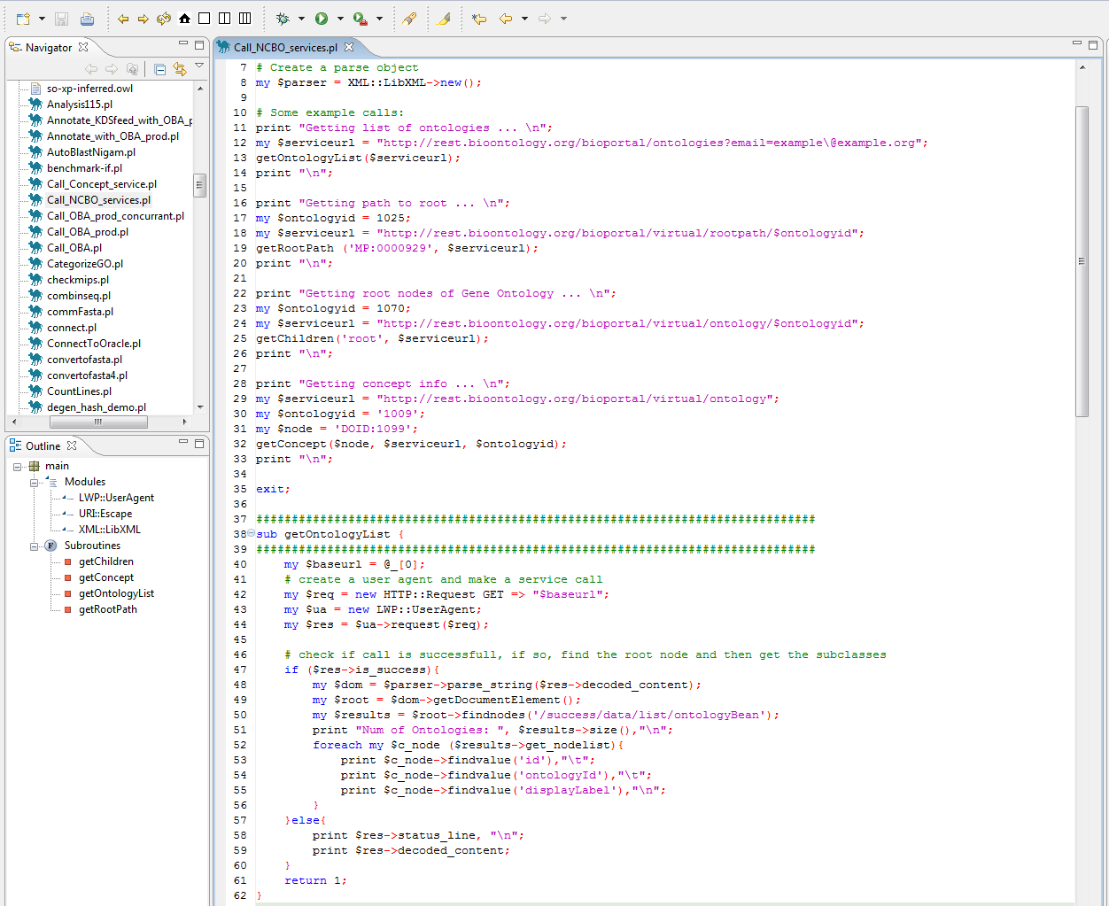
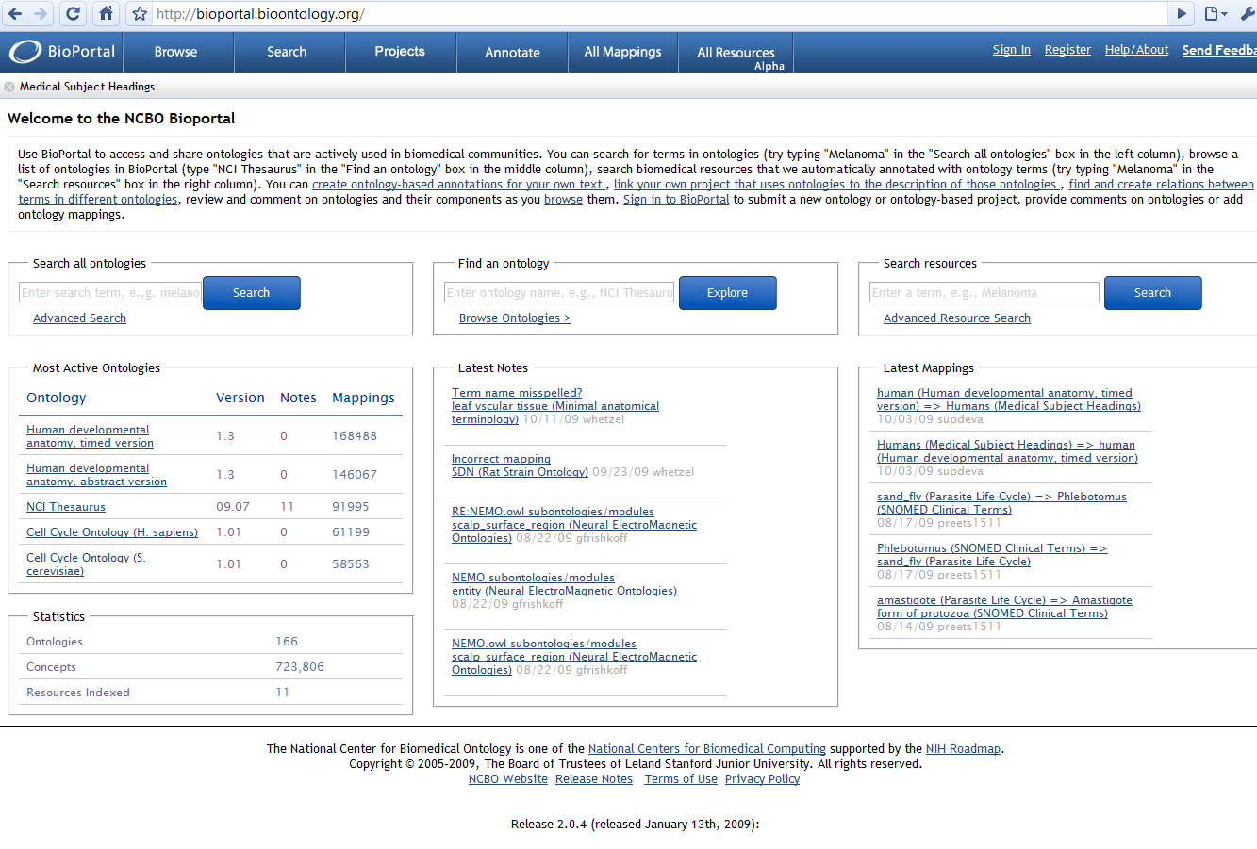
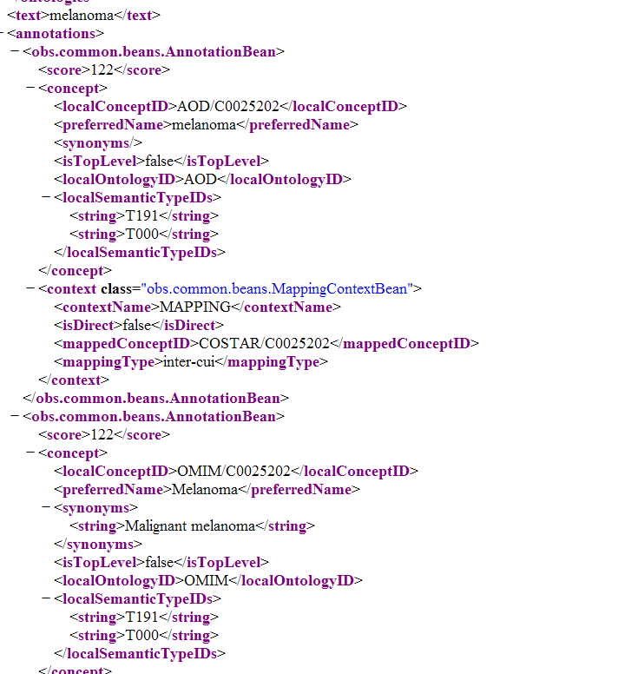
Code
Specific UI
http://rest.bioontology.org/<SERVICE>

Slide 32
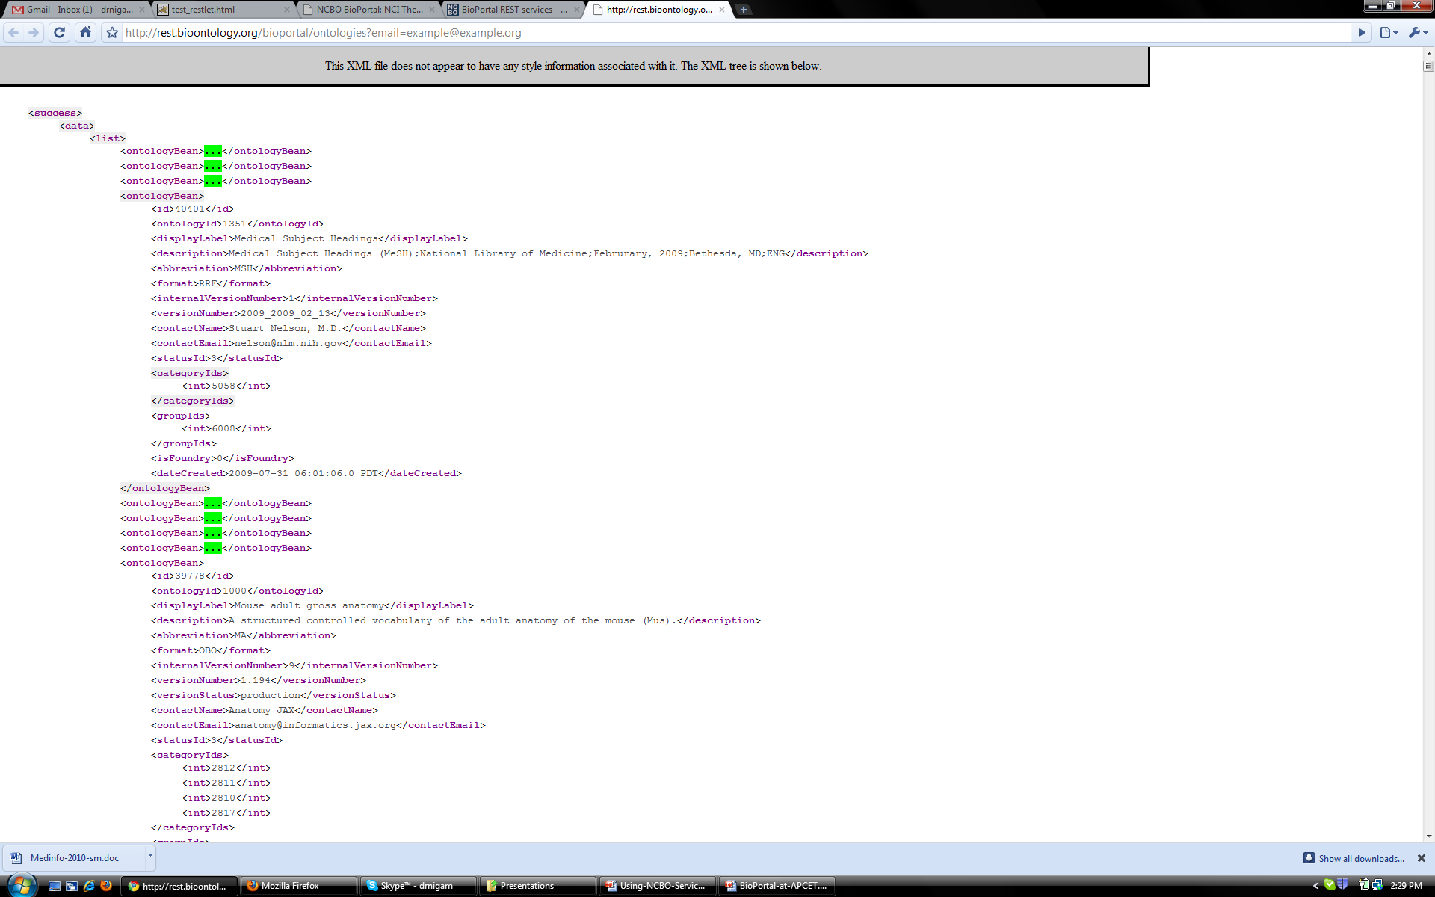
http://rest.bioontology.org/bioportal/ontologies

Slide 33
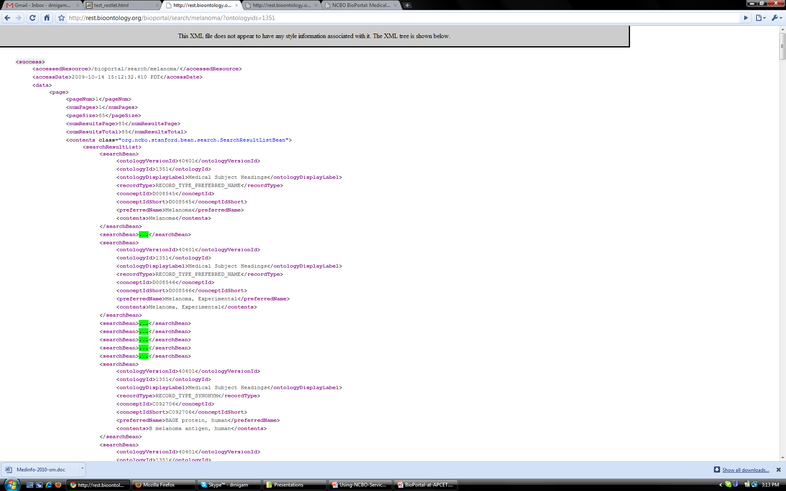
http://rest.bioontology.org/bioportal/search/melanoma/?ontologyids=1351

Slide 34
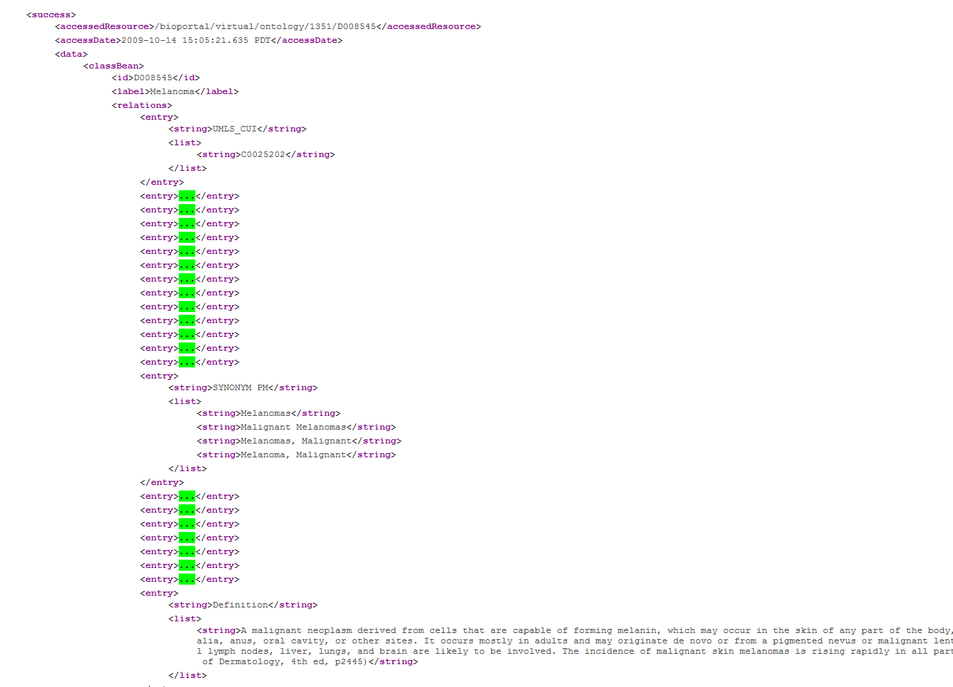
http://rest.bioontology.org/bioportal/virtual/ontology/1351/D008545

Slide 35
References
P Khatri, S Draghici: Ontological analysis of gene expression data: current tools, limitations, and open problems. Bioinformatics 2005, 21:3587-95.
NH Shah, NV Fedoroff: CLENCH: a program for calculating Cluster ENriCHment using the Gene Ontology. Bioinformatics 2004, 20:1196-7.
DL Gold, KR Coombes, J Wang, B Mallick: Enrichment analysis in high-throughput genomics--accounting for dependency in the NULL. Brief Bioinform 2006.
P Glenisson, B Coessens, S Van Vooren, J Mathys, Y Moreau, B De Moor: TXTGate: profiling gene groups with text-based information. Genome Biol 2004, 5:R43.
S Myhre, H Tveit, T Mollestad, A Laegreid: Additional gene ontology structure for improved biological reasoning. Bioinformatics 2006, 22:2020-7.
A Subramanian, P Tamayo, VK Mootha, S Mukherjee, BL Ebert, MA Gillette, A Paulovich, SL Pomeroy, TR Golub, ES Lander, et al: Gene set enrichment analysis: a knowledge-based approach for interpreting genome-wide expression profiles. Proc Natl Acad Sci U S A 2005, 102:15545-50.
Jonquet CM, Musen MA and Shah NH: Building a Biomedical Ontology Recommender Web Service. Journal of Biomedical Semantics, 2010 Jun 22;1 Suppl 1:S1.
Evani US, Krishnan VG, Kamati KK, Baenziger PH, Bagchi A, Peters BJ, Sathyesh R, Li B, Sun Y, Xue B, Shah NH, Kann MG, Cooper DN, Radivojac P and Mooney SD: In Silico Functional Profiling of Human Disease-Associated and Polymorphic Amino Acid Substitutions. Hum Mutat. 2010 Jan 5;31(3):335-346
Shah NH, Bhatia N, Jonquet CM, Rubin DL, Chiang AP and Musen MA: Comparison of Concept Recognizers for building the Open Biomedical Annotator. BMC Bioinformatics 2009, 10(Suppl 9):S14
Noy NF, Shah NH, Whetzel PL, Dai B, Dorf M, Griffith N, Jonquet CM, Rubin DL, Storey MA, Chute CG, Musen MA: BioPortal: ontologies and integrated data resources at the click of a mouse. Nucleic Acids Res. 2009 Jul 1; 37(Web Server issue):W170-3
Shah NH, Jonquet CM, Chiang AP, Butte AJ, Chen R and Musen MA: Ontology-driven Indexing of Public Datasets for Translational Bioinformatics. BMC Bioinformatics 2009, 10(Suppl 2):S1
Rob Tirrell, Uday Evani, Ari E. Berman, Sean D. Mooney, Mark A. Musen and Nigam H. Shah: An Ontology-Neutral Framework for Enrichment Analysis. AMIA Annu Symp Proc. 2010 in press

