Slide 1
Asking translational research questions using ontology enrichment analysis
Nigam Shah
nigam@stanford.edu

Slide 2
High throughput data
“high throughput” is one of those fuzzy terms that is never really defined anywhere
Genomics data is considered high throughput if:
  You can not “look” at your data to interpret it
  Generally speaking it means ~ 1000 or more genes and 20 or more samples.
There are about 40 different high throughput genomics data generation technologies.
  DNA, mRNA, proteins, metabolites … all can be measured

Slide 3
How do ontologies help?
An ontology provides a organizing framework for creating “abstractions” of the high throughput data
The simplest ontologies (i.e. terminologies, controlled vocabularies) provide the most bang-for-the-buck
  Gene Ontology (GO) is the prime example
More structured ontologies – such as those that represent pathways and more higher order biological concepts – still have to demonstrate real utility.

Slide 4
Analyzing Microarray data
Black box of Analysis
Raw Data:
Preprocessing:
Spike Normalization
Flag ‘bad’ spots
Handling duplicates
Filtering
Transformations
Lists of “Significantly changing” Genes.
End up: ‘Story telling’
Notes:
Once data preprocessing is performed then the data are subjected to statistical testing for significance…
Where we try to identify patterns of various types:
similarity between expression profiles over time
similarity b/w expression profiles over samples / replicates
similarity b/w experiment over time / conditions
At the end of the day the experimental biologist is often confronted with long lists of “interesting genes” using which we have to tell a STORY.
The way much of biology works is by applying prior knowledge (‘what is known’) for interpreting datasets rather than the application of a set of axioms that will elicit knowledge. (Stevens et al, 2000)
We need to explicitly articulate ‘what is known’…

Slide 5
Gene Ontology to interpret microarray data

Slide 6
What is Gene Ontology?
An ontology is a specification of the concepts & relationships that can exist in a domain of discourse. (There are different ontologies for various purposes)
The Gene Ontology (GO) project is an effort to provide consistent descriptions of gene products.
The project began as a collaboration between three model organism databases: FlyBase (Drosophila),the Saccharomyces Genome Database (SGD) and the Mouse Genome Database (MGD) in 1998. Since then, the GO Consortium has grown to include most model organism databases.
GO creates terms for: Biological Process (BP), Molecular Function (MF), Cellular Component (CC).

Slide 7
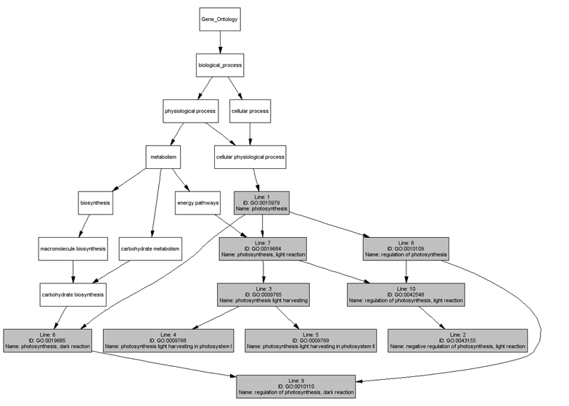
Structure of GO relationships

Slide 8
Generic GO based analysis routine
Get annotations for each gene in list
Count the occurrence (x) of each annotation term
Count (or look up) the occurrence (y) of that term in some background set (whole genome?)
Estimate how “surprising” it is to find x, given y.
Present the results visually.

Slide 9
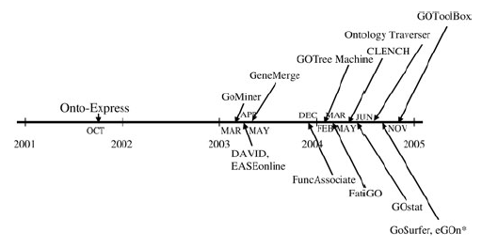
GO based analyses tools – time line
Khatri and Draghici, Bioinformatics, vol 21, no. 18, 2005, pg 3587-3595
http://www.geneontology.org/GO.tools.microarray.shtml

Slide 10
Notes:
If we can some how see groupings along all three data types (expression, annotation, promoter TF sites) simultaneously it would be very valuable in interpreting gene clusters.

Slide 11
Clench inputs
A list of ‘background genes’, one per line.
A list of ‘cluster genes’, one per line.
A FASTA format file containing the promoter sequences of the genes under study.
A tab delimited file containing the TF sites (consensus sequence) to search for in the promoters of genes.
A tab delimited file containing the expression data for the cluster genes.

Slide 12
P-values and False Discover rates
Uses a theoretical distribution to estimate: “How surprising is it that n genes from my cluster are annotated as ‘yyyy’ when m genes are annotated as ‘yyyy’ in the background set”
CLENCH uses the hypergeometric, chi-square and the binomial distributions.
Clench performs simulations to estimate the False Discovery Rate (FDR) at a p-value cutoff of 0.05.
If the FDR is too high, Clench will reduce the p-value cutoff till the FDR is acceptable
The FDR can also be reduced by using GO - Slim:
M
N
m
n
Notes:
The p-value calculation can be viewed in different ways:
1 – we can think of the process of assigning genes to a category as binomial process…
2 – Or we can try to find the significance of the difference between two proportions using Chi-square
3 – view it as a 2-category assignment. Belonging to ‘yyyy’ or ‘not-yyyy’…{without replacement} and use the hypergeometric distribution.
we assume independence of categories which is not really true.
However, we can not be *sure* that the process of assigning GO-annotations to genes follows some theoretical distribution therefore it is essential to get an estimate of the false positives to expect in our result.
Generally, the FDR of a category with more than 5-6 genes is less than 0.3.
A p-value estimated during the simulation follows the binomial distribution more
closely than the hypergeometric (contrary to popular belief!)
Clench performs simulations to estimate the False Discovery Rate (FDR) at a (hypergeometric) p-value cutoff of 0.05.
False discovery rate falls on reducing the p-value cutoff for calling a category significant
Or when the number of genes in a category is large enough.
If the FDR is too high, Clench will reduce the p-value cutoff till the FDR is acceptable
The reduction can be same for all categories.
Or “stepped” where the cutoff is reduced by a larger amount for smaller categories and by a smaller amount for large categories. [depending on the specific FDR for a category of a particular size]
The FDR can also be reduced by using Slim Term mapping: which ensures that each category has a large number of genes assigned to it and hence the FDR is low to begin with.

Slide 13
Results

Slide 14
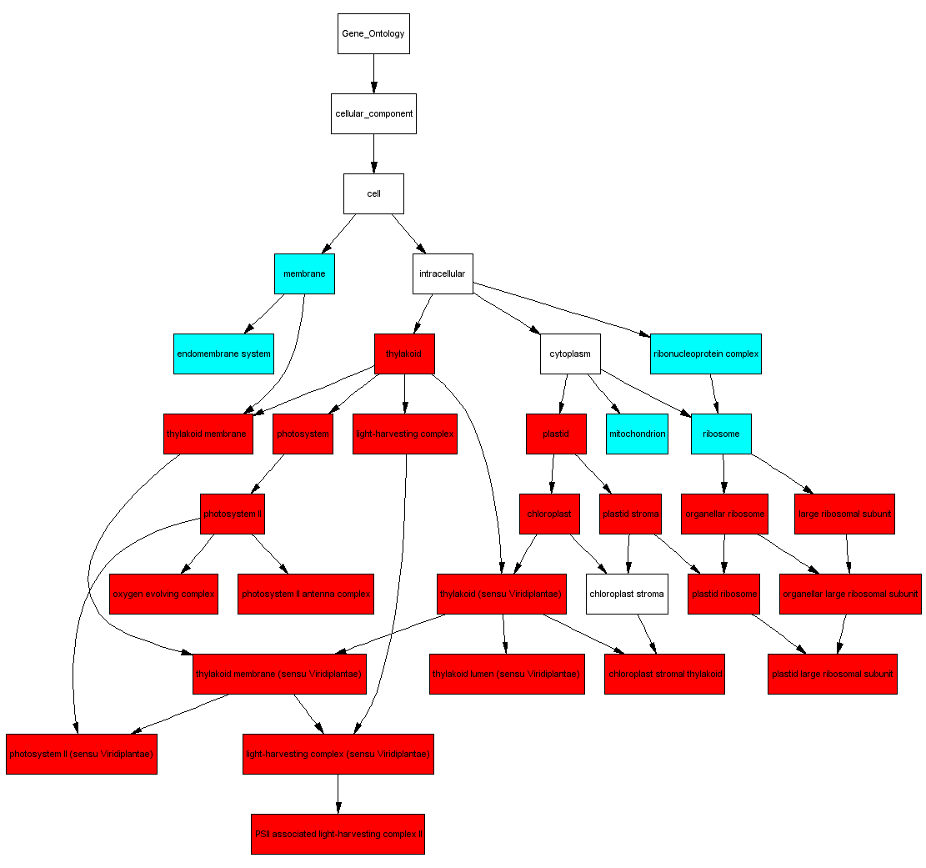
DAG of GO terms
The graph shows relations between enriched GO terms.
Red → Enriched terms
Cyan → Informative high level terms with a large number of genes but not statistically enriched.
White → Non informative terms (defined as an ‘ignore list’ by the user)

Slide 15
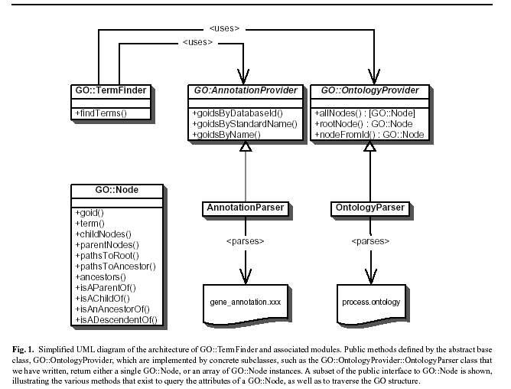
GO – TermFinder

Slide 16
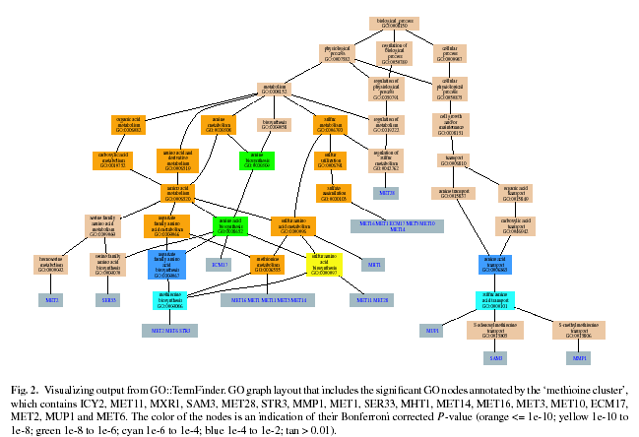
GO – TermFinder
http://db.yeastgenome.org/cgi-bin/GO/goTermFinder

Slide 17
Lots of assumptions!
That the GO categories are independent
  Which they are not
That statistically “surprising” is biologically meaningful
Annotations are complete and accurate
  There is a lot of annotation bias
Multiple functions, context dependent functions are ignored
“Quality” of annotation is ignored

Slide 18
Paper about the “null” assumption

Slide 19
Teasers and food for thought

Slide 20
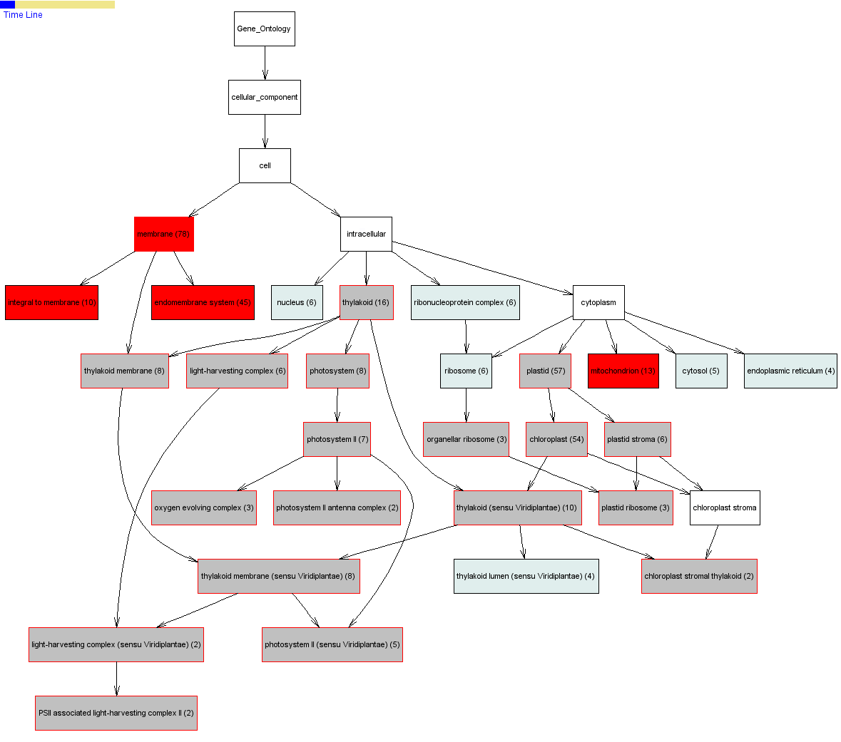
What about the temporal dimension?
Overlay time course data onto the GO tree.
See how the ‘enriched’ categories change over time.
Notes:
Another issue ignored by most ontologies is the time-dependence of annotations. A particular gene product is in a particular cellular compartment at a particular time…and that can change at a subsequent time. Most current GO analyses programs do not factor in the temporal dimension, which I believe is important.
[See the slide in “view slide show” mode to see the animation]

Slide 21
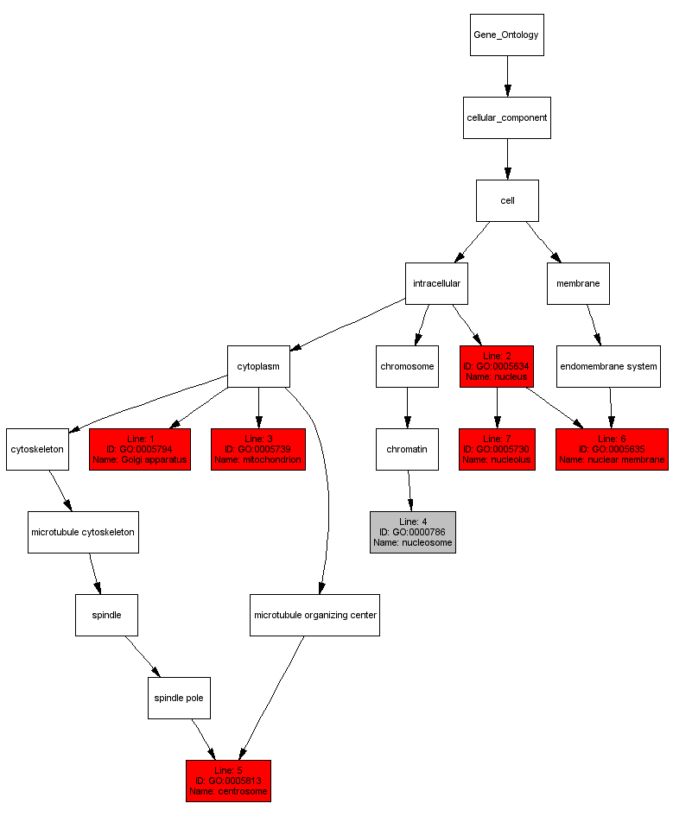
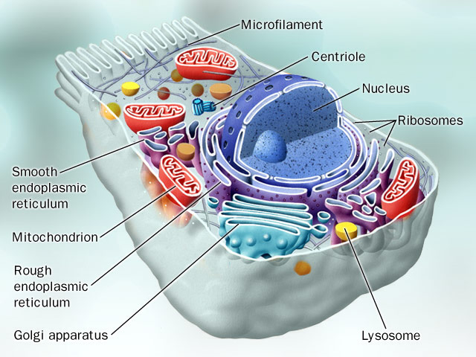
What about 3D structure?
Notes:
The Cellular component ontology also has a 3D interpretation…this can be made explicit by augmenting the cellular location ontology with clearly expressed relations of parthood, adjacency etc. These terms can also be ‘linked’ to a set of co-ordinates in an image.

Slide 22


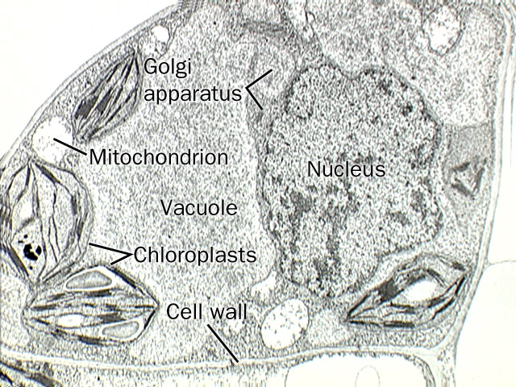
How about time and structure?
Notes:
However, both time and 3d structure matter. Where is a signal sensed? How fast does it travel to the next agent (and where?)… of course, mRNA levels are just part of the story. We’ll need to integrate a lot more data types: Protein expression, Histopathology images, Protein modifications, interaction partners…all keeping in mind the relative orientation (temporal and spatial) of the entities.
If we had all the data explicitly annotated with ontologies that express these relationships, we can perform more “rich” data analysis.
[See the slide in “view slide show” mode to see the animation]

Slide 23
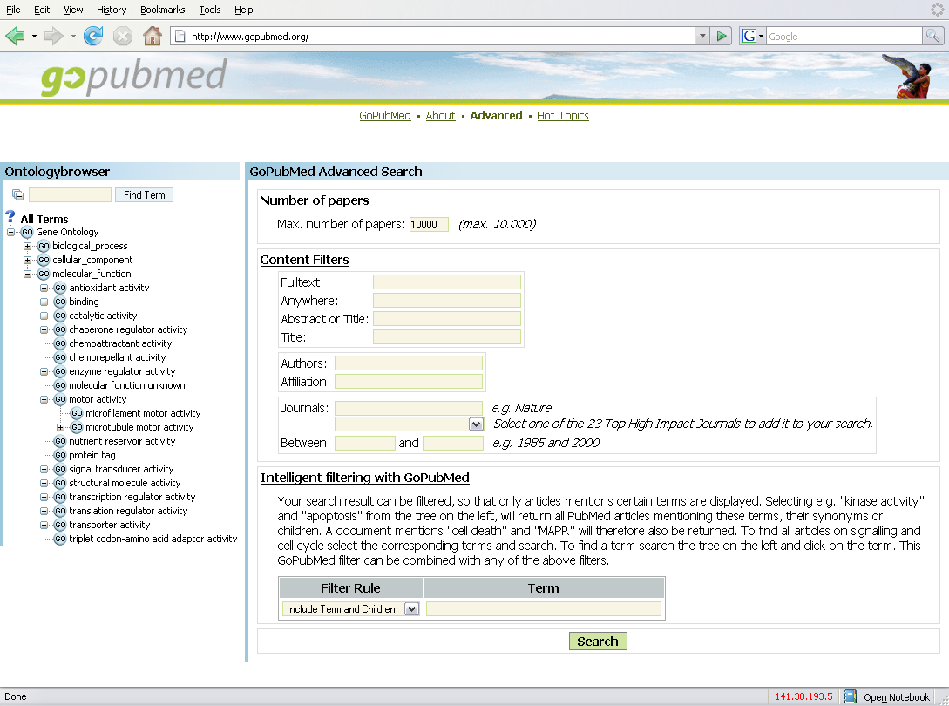
Side note: GO to analyze literature

Slide 24
How does the GO help?
If we explicitly articulate ‘what is known’, in an organizing framework, it serves as a reference for integrating new data with prior knowledge.
Such a framework allows formulation of more specific queries to the available data, which return more specific results and increase our ability to fit the results into the “big picture”.
Notes:
organizing framework, explicitly articulates/structures prior biological knowledge and allows us to use it computationally {and serves as a reference for integrating new data with prior knowledge}.

Slide 25
The Gene Ontology provides “structure” to annotations
Notes:
If we can some how see groupings along all three data types (expression, annotation, promoter TF sites) simultaneously it would be very valuable in interpreting gene clusters.

Slide 26
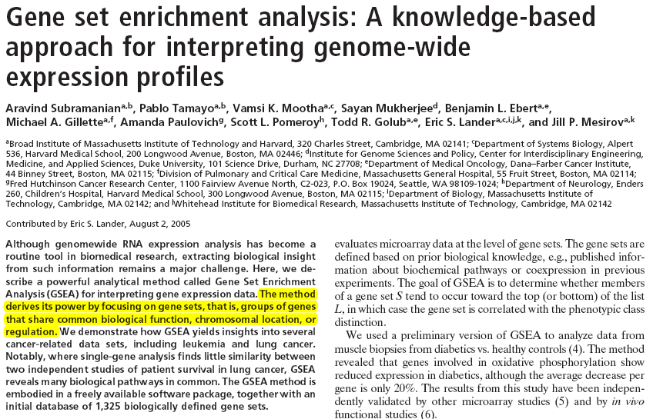
A bit more structure than GO…

Slide 27
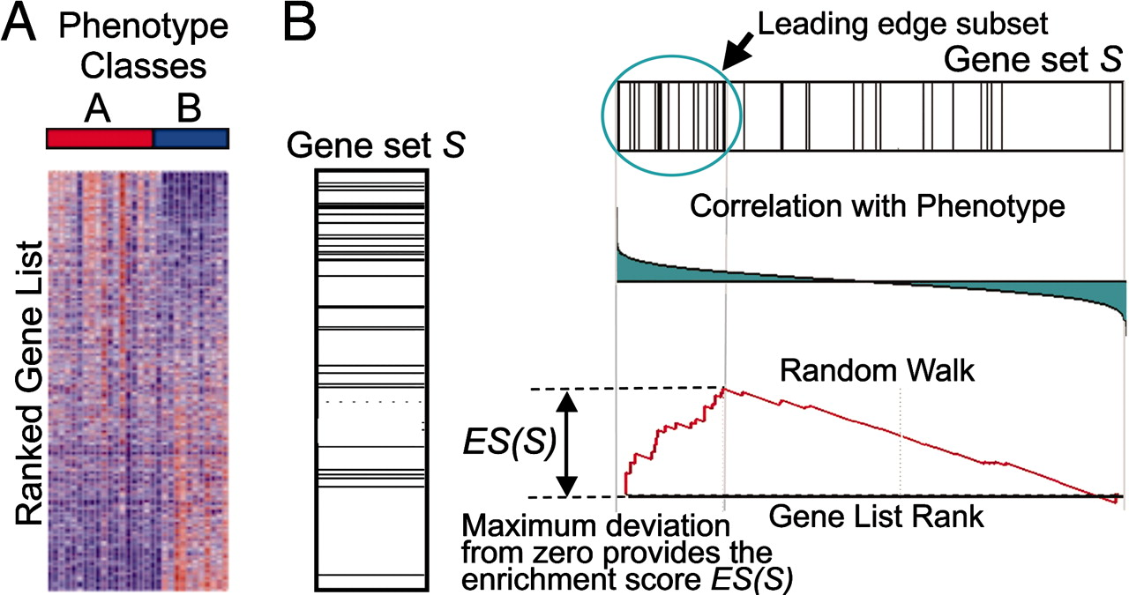
“Functional” Grouping

Slide 28
… still more structure
?<link>?
<Some MF> in <Some BP>

Slide 29
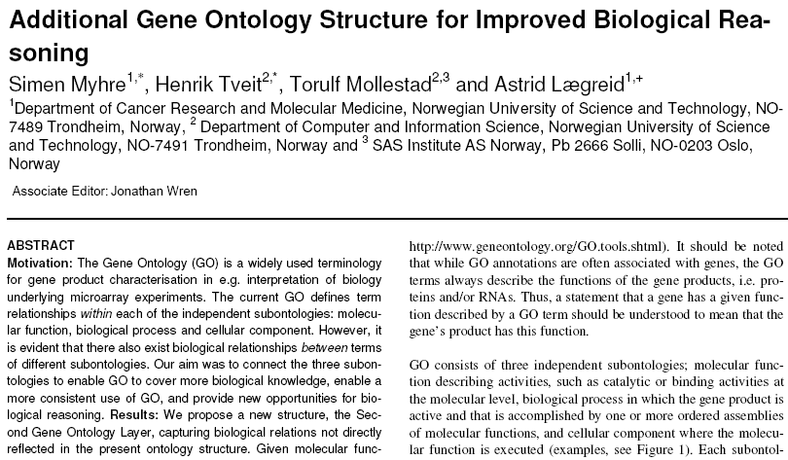
Between-ontology structure

Slide 30
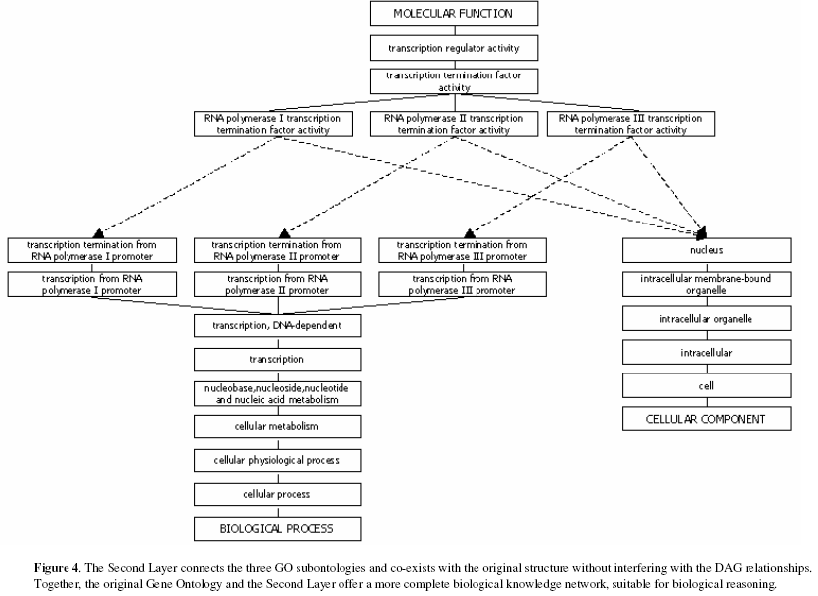

Slide 31
Literature is the ultimate source of annotations … but it is unstructured!
Notes:
If we can some how see groupings along all three data types (expression, annotation, promoter TF sites) simultaneously it would be very valuable in interpreting gene clusters.

Slide 32
Text mining for “interpreting” data
The goal is to analyze a body of text to find disproportionately high co-occurrences of known terms and gene names.
Or analyze a body of text and hope that the group of genes as a whole gets associated with a list of terms that identify themes about the genes.
 | A | B | C | D | E
Label-1 | 5 | 0 | 1 | 0 | 1
Label-2 | 3 | 2 | 0 | 9 | 4
Label-3 | 16 | 5 | 1 | 0 | 4
Label-4 | 0 | 7 | 9 | 5 | 5
Label-5 | 1 | 2 | 24 | 18 | 7
 | XPA | B | ERCC1 | D | E
Label-1 | 5 | 0 | 1 | 0 | 1
Label-2 | 3 | 2 | 0 | 9 | 4
Mismatch repair | 16 | 5 | 1 | 0 | 4
Label-4 | 0 | 7 | 9 | 5 | 5
Nucleotide Excision repair | 1 | 2 | 24 | 18 | 7
 | A | B | C | D | E
Recombination | 15 | 0 | 10 | 0 | 17
Xeroderma Pigmentosum | 30 | 12 | 0 | 19 | 14
Mismatch repair | 16 | 15 | 21 | 0 | 40
DNA repair | 0 | 7 | 19 | 50 | 5
Nucleotide Excision repair | 14 | 12 | 20 | 18 | 17

Slide 33
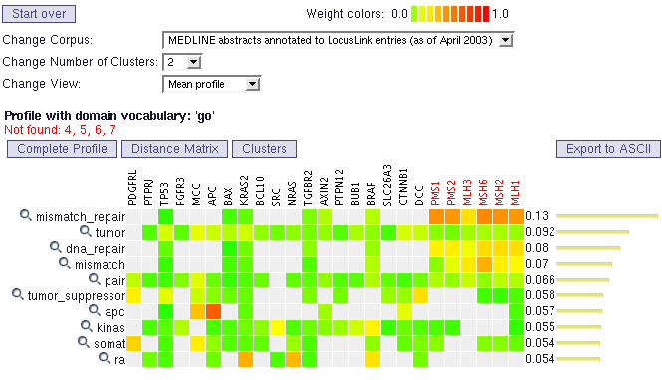

Slide 34
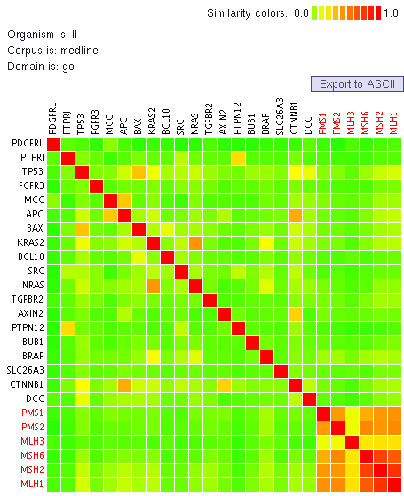
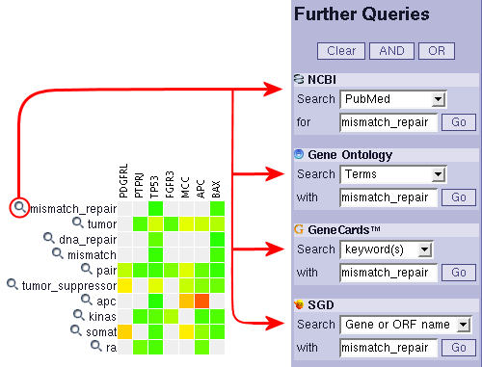

Slide 35
Pathway analysis

